Slide 1
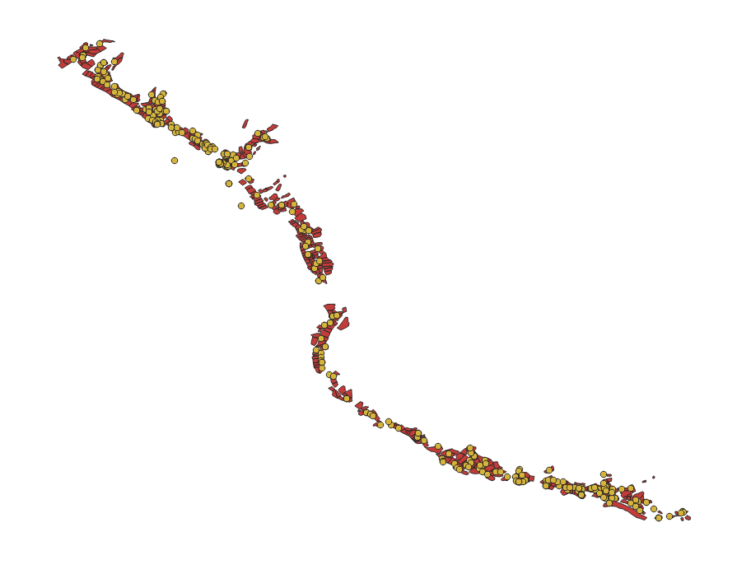
Toshkent viloyati, Angren shahar, Lashkerak Mfy
401 xonadon
2209 respondent

Slide 2
